Slide 1
Identifying Smokers in Unstructured Data Using Natural Language Processing
Peter A Noble PhD

Slide 2
Example of Electronic Health Record (EHR) from n2c2 NLP Research Data Sets
<RECORD ID="515">
HISTORY OF PRESENT ILLNESS :
This 68-year-old patient of Dr. <PHI TYPE="DOCTOR">Naka Jesc</PHI> had two episodes of rheumatic fever as a teenager .
She has had chronic atrial fibrillation .
Coumadin has caused bleeding from the mouth and nose on two occasions , on one occasion with prothrombin time 13 , and has been replaced by anti-platelet agents .
She has had recurrent syncope since age 6 .
She has now had progressive heart failure .
A Holter showed atrial fibrillation with period of ventricular bigemini .
She cut down dramatically on smoking two years ago , but has continued to smoke , although , very recently , she admits to only &quot; two puffs &quot; per day .
She has not had hypertension or diabetes , and says he has lowered her cholesterol from 333 to 197 by changing her diet .
There is no family history of heart disease .
She has been treated with Vanceril for chronic obstructive pulmonary disease .
She has had one gram per day proteinuria with normal creatinine .
She had a partial gastrectomy in 1972 for a &quot; tumor &quot; .
She has had an appendectomy and cholecystectomy .
</RECORD>

Slide 3
Extracted words from EHR
Extracting program: extract_target_words.cpp
Uses target file containing synonyms: “smoke”, ”smoking”, “smoker”, “smoked”, “tobacco”, “cigar”, ”exsmoker”, ”nonsmoker”, “tobac”, “tabac”.
id_515 of ventricular bigemini she cut down dramatically on smoking two years ago but has continued to smoke
[nine words on either side of the target word]
Next: code as smoke [1] or non-smoker [0]

Slide 4
Extracting words around the target
Electronic Medical Files
Extracted_target.words_out.txt
Extract_target_words.cpp
Target.txt

Slide 5
Manual coding (not all words not shown)
id_ 513 | 1 | history | is | remarkable | for | chronic | lung | disease | due | to | Smoking….
id_ 514
id_ 515 | 1 | of | ventricular | bigemini |  | she | cut | down | dramatically | on | smoking
id_ 516
id_ 517
id_ 518 | 0 | of | intravenous | drug | abuse |  | no | alcohol | abuse | or | tobacco
id_ 519 | 0 | amoxicillin |  | having | developed | a | rash |  | does | not | smoke
1: Smoker
0: Nonsmoker

Slide 6
Pre-trained Vectorization
Words converted to vectors
Several different sources of vectorization files: e.g., Wilkipedia, PubMed
Vector files range from 200 to 300 attributes
What is the optimal number of attributes per word?
Can be determined by ANN performance using test files
Program called vector_extraction2.cpp

Slide 7
Extracting words around the target
Extracted words
Found_words
Vector_extraction2.cpp
Word vectors by patient
Word vectors file

Slide 8
Found_words
Not all words in the extraction file will be found in the ‘word vector’ file.
The ‘found words’ only represent those that were identified

Slide 9
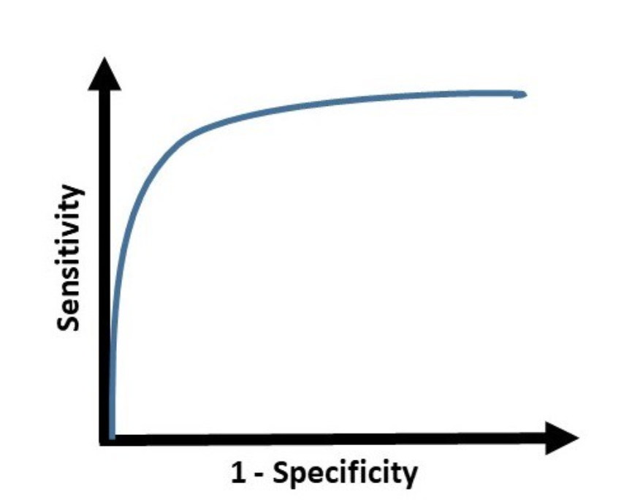

Word vectors by patient file
Valid_x.txt
Test_x.txt
Train_x.txt
Neuroet Model
Train_y.txt
Test_y.txt
Predictions
Valid_y.txt

Slide 10
Final model
Electronic Medical Files
Neuroet Model Equation
Extract target words
Convert words to vectors
Predictions
Target words
Word vector file

Slide 11
Number of vector attributes, average model accuracy (n=3) and average AUC (n=3) using test dataset.
Vector size of 100 and 8 hidden neurons is optimal

Slide 12
AUC (93.5%) using Test Dataset

Slide 13
Confusion matrix of model
Vector attribute size of 100, 8 hidden neurons, and 311 records of Test Dataset.
Actual classification:
202 patients who smoke (Yes)
109 patients who do not smoke (No).
Prediction of <0.5 were classified as non-smoker and >= 0.5 were classified as smokers.

Slide 14
Confusion Matrix of Test Dataset
TP- true positive; TN – True negative; FP - False positive; FN - False negative. The model has an accuracy of 88.7% (276/311) and an AUC of 93.6, meaning that 6.4% of the variability in the data was no accounted for.

Slide 15
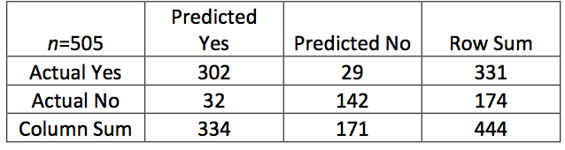
Confusion Matrix of Validation Dataset
Medication Validation Dataset from n2c2
505 records had “smoking” synonyms
331 positive for smoking
174 negative for smoking

Slide 16
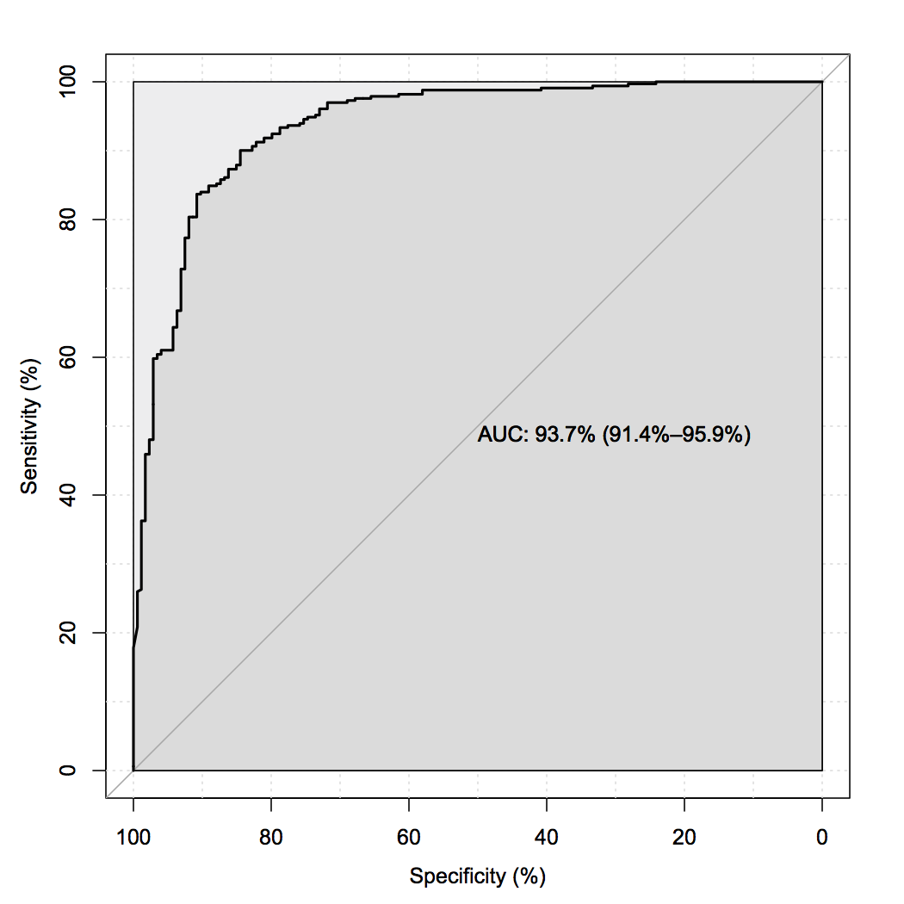
AUC (93.7%) for Validation

Slide 17
Shuffling the words affect model predictions?
Examined if the order of the text was an important factor used by the ANN to predict smoking or not
Created a program called ‘random_text.cpp’ that shuffles the order of words in sentences extracted electronic medical records

Slide 18
An example
Original record:
ob_1 0 with her daughter in news irv in she denies tobacco use and drinks alcohol rarely allergies codeine and benadryl admission
Randomized record:
ob_1 0 she and alcohol admission in with in irv allergies daughter rarely codeine drinks use her benadryl denies tobacco and news
Ob_1: Obesity patient 1
0: non-smoker
Note: target word ‘ tobacco’ has shifted from the middle of the sentence to the third from end.

Slide 19
Confusion matrix using the 622 records of a shuffled test set
Actual classification includes 401 patients who smoke (Yes) and 221 patients served as negative controls (No).
The model has an accuracy of 71.4% (444/622) and an AUC of 76.4, meaning that 23.6% of the variability in the data was not accounted for.

Slide 20
Results: Order of the words has some importance to predictions
Accuracy decreased from 86.2% to 71.4%
AUC decreased from 90.5% to 76.4%
Is the position of the target words in the center of the sentence important?
Repeated ‘crude’ experiment by placing target word to the center of the sentence.

Slide 21
Confusion Matrix of Centered Data
From previous Confusion Matrix (CM), the new CM improved accuracy from 71.4% to 74.8% and AUC improved from 76.4% to 79.9%.
Results suggest that centering of the target word has some value to prediction.

Slide 22
Summary
All programs are custom-designed C++ (except R for AUC determination) because SpaCy and other programs are too slow.
Model can be extracted from Neuroet and made into a standalone model.
All programs can be put into a Unix script with a User Interface.
We showed the ability to accurately predict if patient is a smoker or not from EHRs.
We showed that position of the target work in the extraction program is important for predictions.

